Slide 1
Supervised Learning and k-Nearest Neighbors
Dr. Asim Imdad Wagan

Slide 2
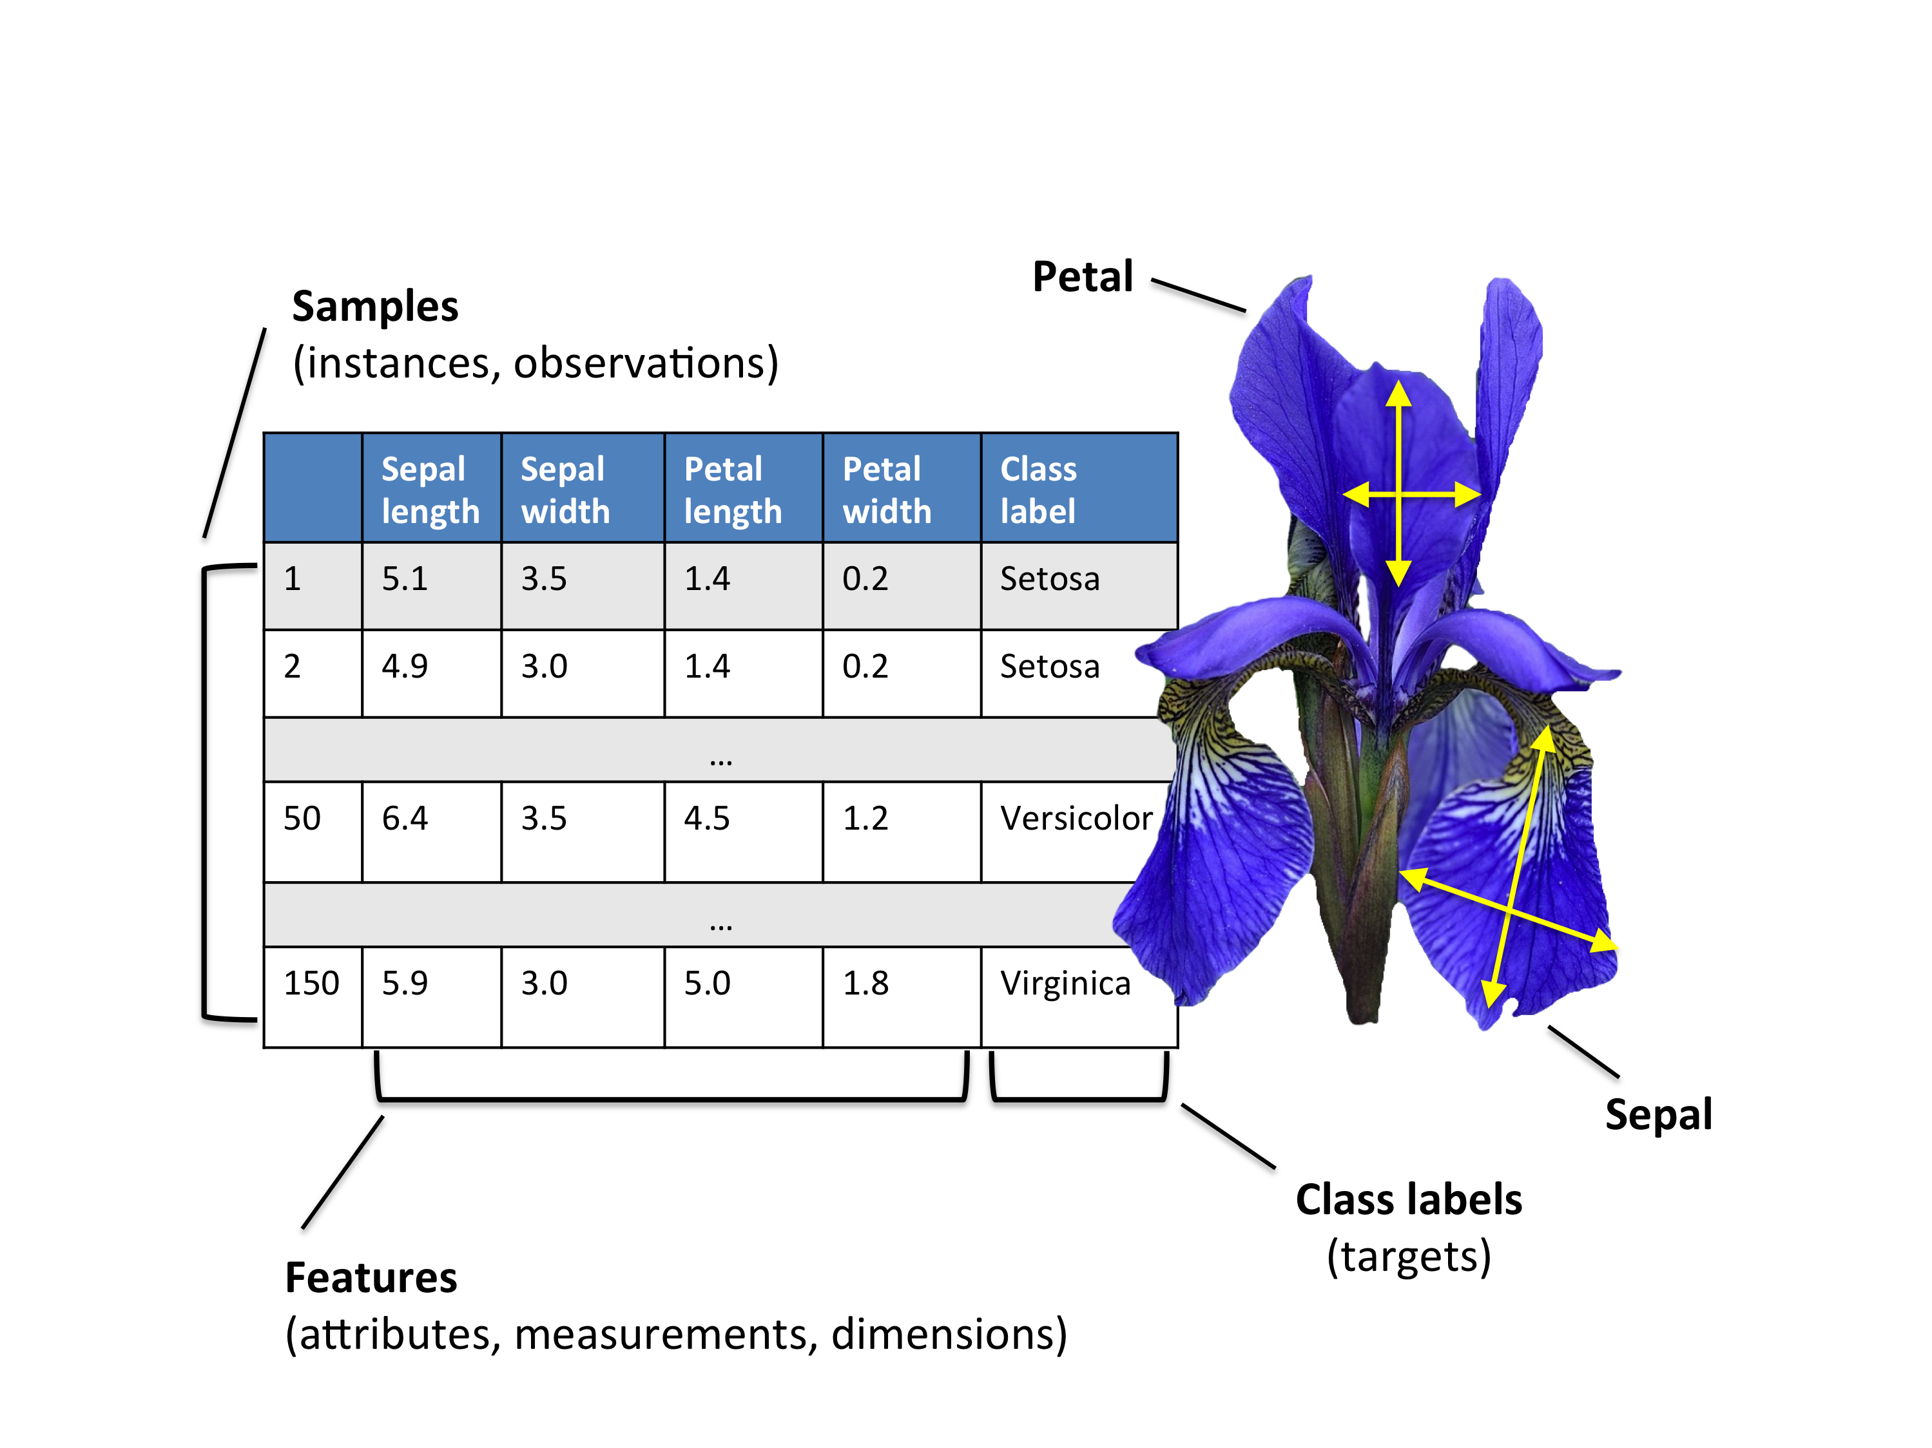
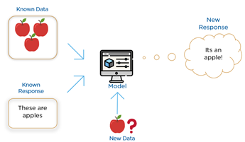
Introduction
Supervised learning consists of those sets of algorithms which predict an output/class/responses/dependent variables based on some inputs/features/predictors/independent variables.

Slide 3
Variable Types
Data Types
Categorical
Numerical
Nominal
Ordinal
Interval
Ratio

Slide 4
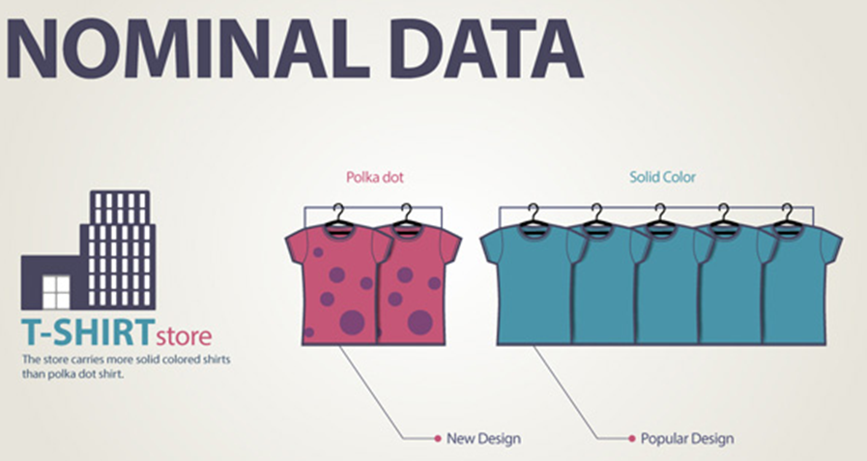
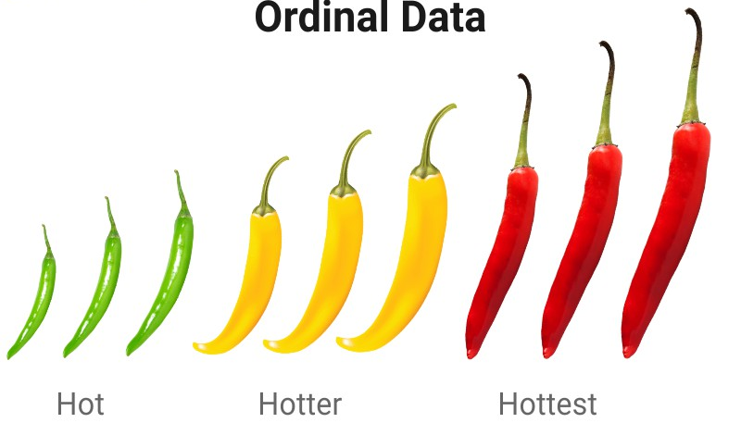

Categorical Data
Categorical data represents characteristics.
Therefore it can represent things like a person’s gender, language etc. Categorical data can also take on numerical values (Example: 1 for female and 0 for male).
Note that those numbers don’t have mathematical meaning.

Slide 5
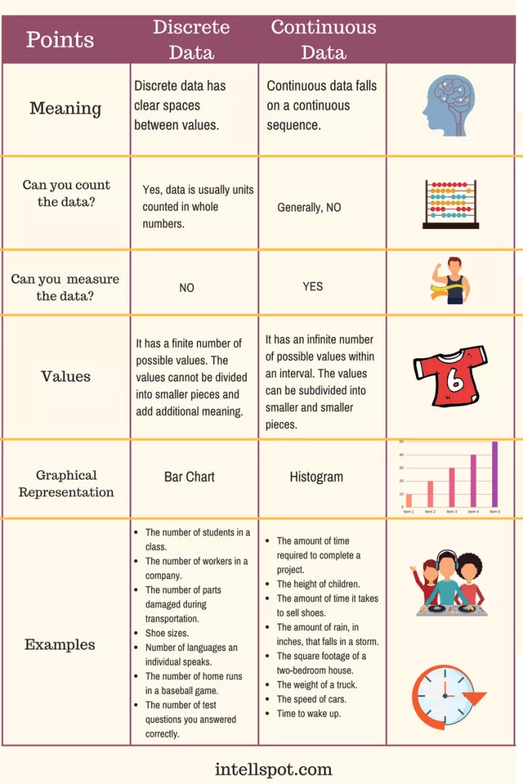
Numerical Data

Slide 6
Example 1: Email Spam
Data:
4601 email messages
each labeled email (+) or spam (-)
The relative frequencies of the 57 most commonly occurring words and punctuation marks in the message
Prediction goal: label future messages email (+) or spam (-)
Supervised learning problem on categorical data: classification problem
 | spam | email
george | 0.00 | 1.27
you | 2.26 | 1.27
your | 1.38 | 0.44
hp | 0.02 | 0.90
free | 0.52 | 0.07
hpl | 0.01 | 0.43
! | 0.51 | 0.11
our | 0.51 | 0.18
re | 0.13 | 0.42
edu | 0.01 | 0.29
remove | 0.28 | 0.01
Words with largest difference between spam and email shown.

Slide 7
Example 1: Email Spam
Examples of rules for prediction:
If (%george<0.6) and (%you>1.5) then spam else email
If (0.2·%you-0.3 ·%george)>0 then spam else email
Tolerance to errors:
Tolerant to letting through some spam (false positive)
No tolerance towards throwing out email (false negative)
 | spam | email
george | 0.00 | 1.27
you | 2.26 | 1.27
your | 1.38 | 0.44
hp | 0.02 | 0.90
free | 0.52 | 0.07
hpl | 0.01 | 0.43
! | 0.51 | 0.11
our | 0.51 | 0.18
re | 0.13 | 0.42
edu | 0.01 | 0.29
remove | 0.28 | 0.01
Words with largest difference between spam and email shown.

Slide 8
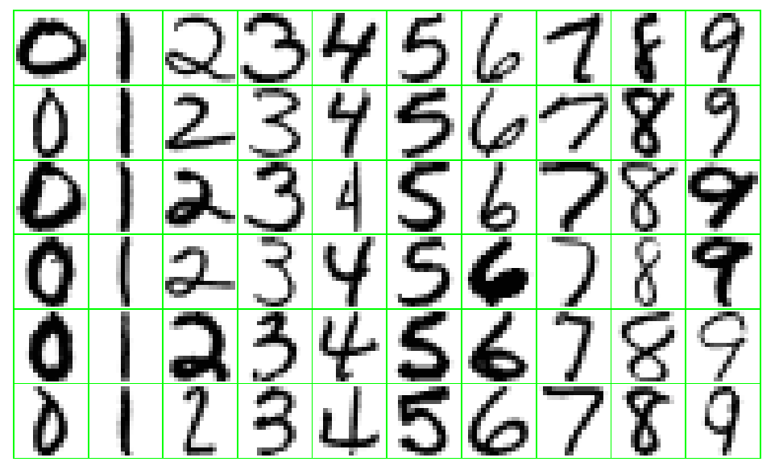
Example 2: Recognition of Handwritten Digits
Data: images are single digits 16x16 8-bit gray-scale, normalized for size and orientation
Classify: newly written digits
Non-binary classification problem
Low tolerance to misclassifications

Slide 9
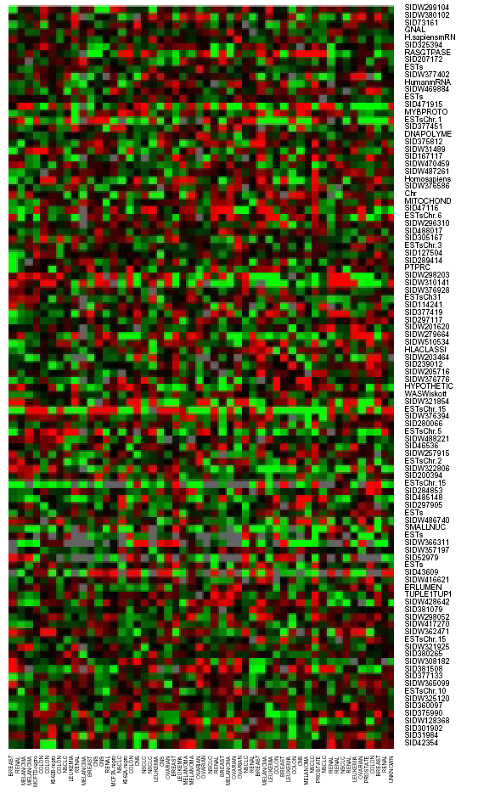
Example 3: DNA Expression Microarrays
Data:
Color intensities signifying the abundance levels of mRNA for a number of genes (6830) in several (64) different cell states (samples).
Red over-expressed gene
Green under-expressed gene
Black normally expressed gene (according to some predefined background)
Predict:
Which genes show similar expression over the samples
Which samples show similar expression over the genes (unsupervised learning problem)
Which genes are highly over or under expressed in certain cancers (supervised learning problem)
samples

Slide 10
Overview of Supervised Learning

Slide 11
Notation
Inputs
X, X_{j} (jth element of vector X )
p #inputs, N #observations
X matrix written in bold
Vectors written in bold x_{i} if they have N components and thus summarize all observations on variable X_{i}
Vectors are assumed to be column vectors
Discrete inputs often described by characteristic vector (dummy variables)
Outputs
quantitative Y
qualitative G (for group)
Observed variables in lower case
The i-th observed value of X is x_{i} and can be a scalar or a vector
Main question of this lecture:
Given the value of an input vector X, make a good prediction Ŷ of the output Y
The prediction should be of the same kind as the searched output (categorical vs. quantitative)
Exception: Binary outputs can be approximated by values in [0,1], which can be interpreted as probabilities
This generalizes to k-level outputs.

Slide 12
Simple Approach 1: Least-Squares
Given inputs X=(X₁,X₂,…,X_{p})
Predict output Y via the model
Include the constant variable 1 in X
Here Y is scalar
(If Y is a K-vector then X is a pxK matrix)
In the (p+1)-dimensional input-output space, (X,Ŷ ) represents a hyperplane
If the constant is included in X, then the hyperplane goes through the origin
is a linear function
is a vector that points in the steepest uphill direction

Slide 13
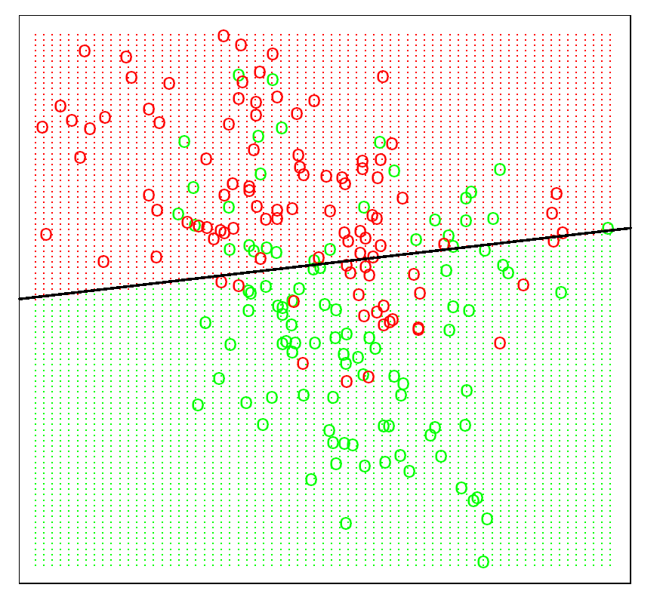
Simple Approach 1: Least-Squares
In the (p+1)-dimensional input-output space, (X,Ŷ ) represents a hyperplane
If the constant is included in X, then the hyperplane goes through the origin
is a linear function
is a vector that points in the steepest uphill direction
β

Slide 14
Simple Approach 1: Least-Squares
Training procedure: Method of least-squares
N = Number of observations
Minimize the residual sum of squares
Or equivalently
This quadratic function always has a global minimum, but it may not be unique
Differentiating w.r.t. β yields the normal equations
If X^{T}X is nonsingular, then the unique solution is
The fitted value at input x is
The entire surface is characterized by .

Slide 15
Simple Approach 1: Least-Squares
Example:
Data on two inputs X₁ and X₂
Output variable has values GREEN (coded 0) and RED (coded 1)
100 points per class
Regression line is defined by
Easy but many misclassifications if the problem is not linear
X₁
X₂

Slide 16
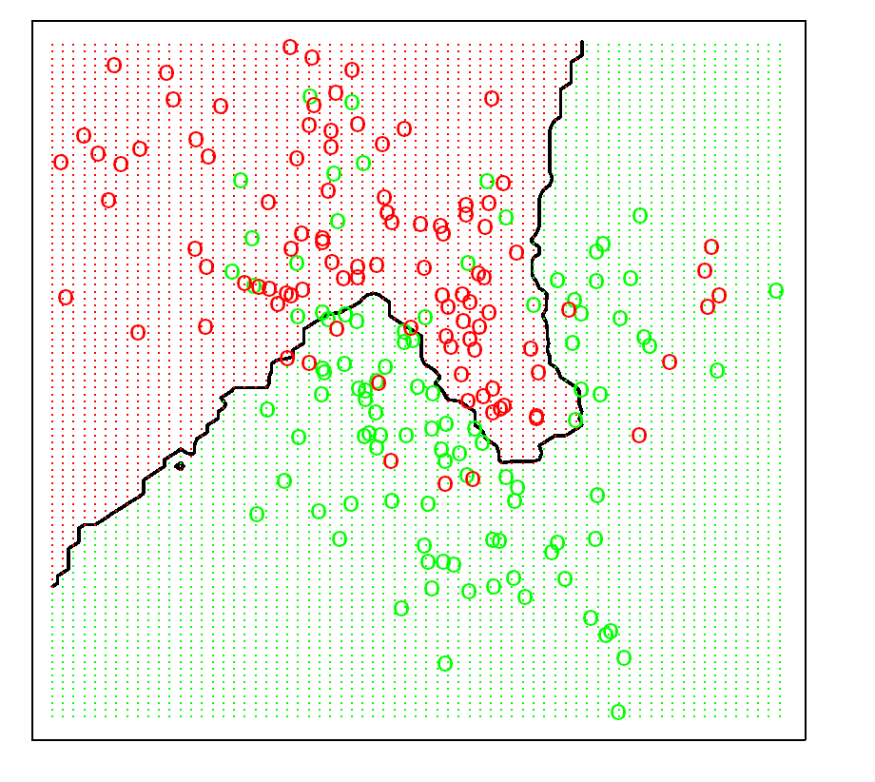
Simple Approach 2: Nearest Neighbors
15-nearest neighbor averaging
Uses those observations in the training set closest to the given input.
N_{k}(x) is the set of the k closest points to x is the training sample
Average the outcome of the k closest training sample points
Fewer misclassifications
X₁
X₂

Slide 17
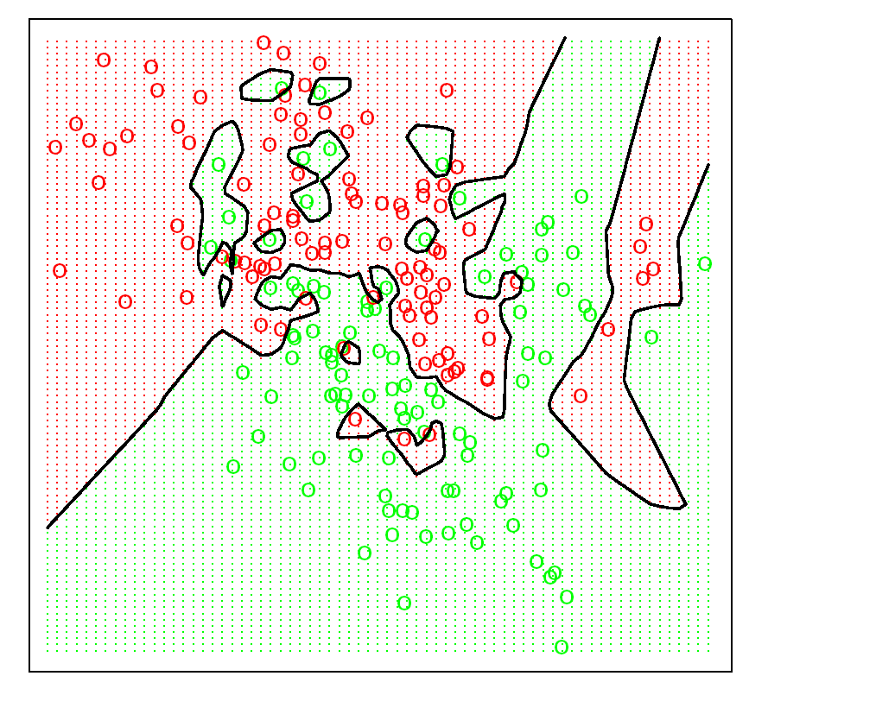
Simple Approach 2: Nearest Neighbors
1-nearest neighbor averaging
Uses those observation in the training set closest to the given input.
N_{k}(x) is the set of the k closest points to x is the training sample
Average the outcome of the k closest training sample points
No misclassifications: Overtraining
X₁
X₂

Slide 18
Comparison of the Two Approaches
Least squares | K-nearest neighbors
p parameters p = # features | Apparently one parameter k In fact N/k parameters N = #observations
Low variance (robust) | High variance (not robust)
High bias (rests on strong assumptions) | Low bias (rests only on weak assumptions)

Slide 19
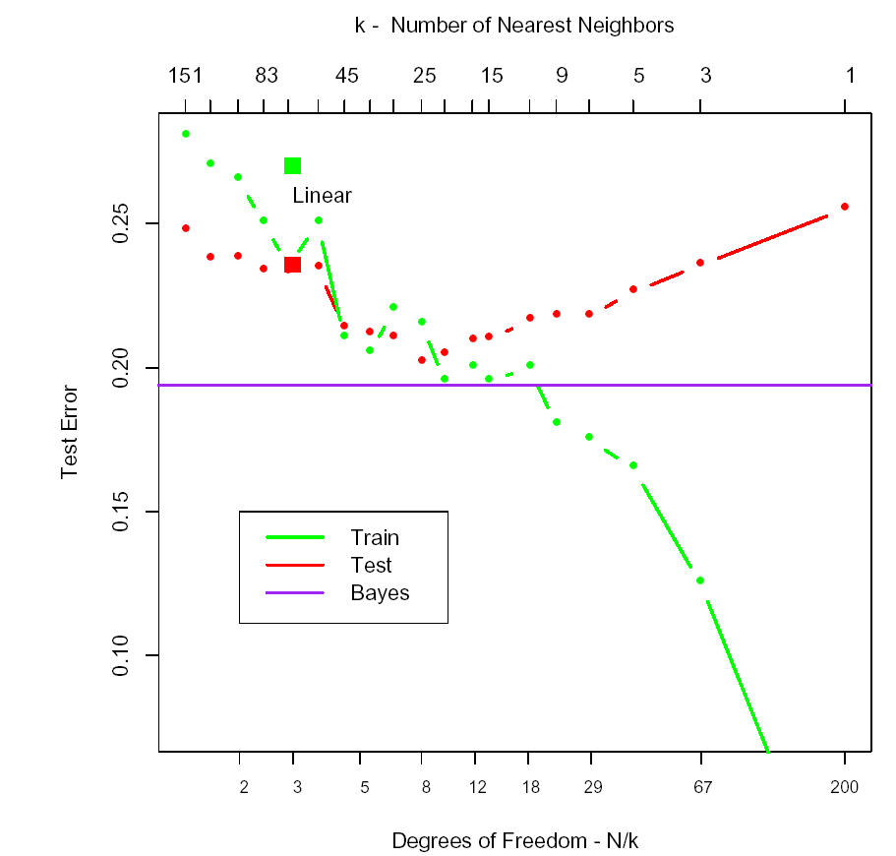
Origin of the Data
Mixture of the two scenarios
Step 1: Generate 10 means m_{k} from the bivariate Gaussian distribution N((1,0)^{T},I) and label this class GREEN
Step 2: Similarly, generate 10 means from the from the bivariate Gaussian distribution N((0,1)^{T},I) and label this class RED
Step 3: For each class, generate 100 observations as follows:
For each observation, pick an m_{k} at random with probability 1/10
Generate a point according to N(m_{k},I/ 5)
Similar to scenario 2
Result of 10 000 classifications

Slide 20
Variants of These Simple Methods
Kernel methods: use weights that decrease smoothly to zero with distance from the target point, rather than the 0/1 cutoff used in nearest-neighbor methods
In high-dimensional spaces, some variables are emphasized more than others
Local regression fits linear models (by least squares) locally rather than fitting constants locally
Linear models fit to a basis expansion of the original inputs allow arbitrarily complex models
Projection pursuit and neural network models are sums of nonlinearly transformed linear models

Slide 21





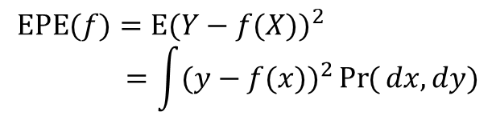

Statistical Decision Theory
Expected prediction error (EPE):
Since Pr(X,Y )=Pr(Y |X )Pr(X )
EPE can also be written as
Thus it suffices to minimize EPE pointwise
$$X∈ℝ^{p}$$
$$\text{EPE}(f)=E(Y−f(X))^{2} \\ =\int{(y−f(x))^{2}}\operatorname{Pr}{(}dx,dy)$$
Random input vector:
Random output variable:
Joint distribution: Pr(X,Y )
We are looking for a function f(x) for predicting Y given the values of the input X
The loss function L(Y, f(X)) shall penalize errors
Squared error loss:
$$Y∈ℝ$$
$$\text{EPE}(f)=E_{X}E_{Y|X}([Y−f(X)]^{2}|X)$$
$$L(Y,f(X))=(Y−f(X))^{2}$$
$$f(x)={argmin}_{c}{E_{Y|X}}([Y−c]^{2}|X=x)$$
Regression function:
$$f(x)=E(Y|X=x)$$

Slide 22


Statistical Decision Theory
Nearest neighbor methods try to directly implement this recipe
Several approximations
Since no duplicate observations, expectation over a neighborhood
Expectation approximated by averaging over observations
With increasing k and number of observations the average gets (provably) more stable
But often we do not have large samples
By making assumptions (linearity) we can reduce the number of required observations greatly.
With increasing dimension the neighborhood grows exponentially. Thus the rate of convergence to the true estimator (with increasing k) decreases
$$\hat{f}(x)=\text{Ave}(y_{i}|x_{i}∈N_{k}(x))$$
Regression function:
$$f(x)=E(Y|X=x)$$

Slide 23


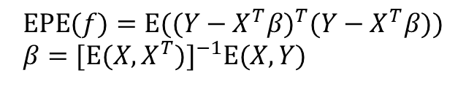
Statistical Decision Theory
Linear regression
Assumes that the regression function is approximately linear
This is a model-based approach
After plugging this expression into EPE and differentiating w.r.t. β, we can solve for β
Again, linear regression replaces the theoretical expectation by averaging over the observed data
Summary:
Least squares assumes that f(x) is well approximated by a globally linear function
Nearest neighbours assumes that f(x) is well approximated by a locally constant function.
$$f(x)≈x^{T}β$$
$$RSS(β)=\sum_{i=1}^{N}{(y_{i}}−x_{i}^{T}β)^{2} \\ \hat{β}=(X^{T}X)^{−1}X^{T}y$$
$$\text{EPE}(f)=E((Y−X^{T}β)^{T}(Y−X^{T}β)) \\ β=[E(X,X^{T})]^{−1}E(X,Y)$$
Regression function:
$$f(x)=E(Y|X=x)$$

Slide 24



Statistical Decision Theory
Additional methods are often model-based but more flexible than the linear model.
Additive models
Each f_{j} is arbitrary
What happens if we use another loss function?
In this case
More robust than the conditional mean
L₁ criterion not differentiable
Squared error most popular
$$L_{1}(Y,f(X))=|Y−f(X)|$$
$$f(X)=\sum_{j=1}^{p}{f_{j}}(X_{j})$$
$$\hat{f}(x)=\text{median}(Y|X=x)$$

Slide 25
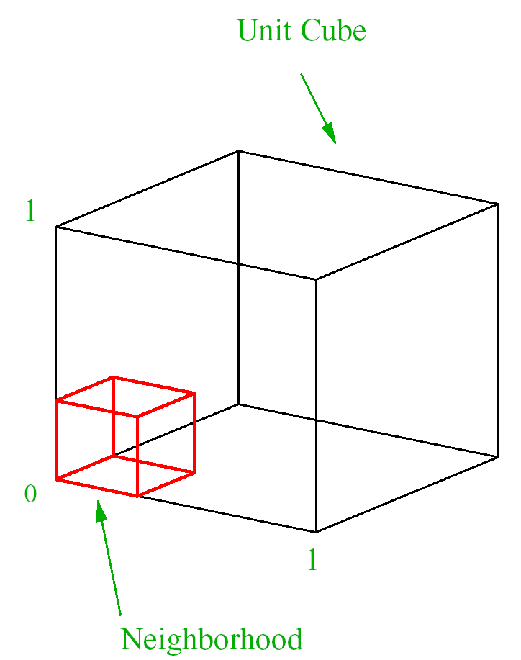
Local Methods in High Dimensions
Curse of Dimensionality: Local neighborhoods become increasingly global, as the number of dimension increases
Example: Points uniformly distributed in a p-dimensional unit hypercube.
Hypercubical neighborhood in p dimensions that captures a fraction r of the data
Has edge length e_{p}(r) = r^{1/p}
e₁₀(0.01) = 0.63
e₁₀(0.1) = 0.82
To cover 1% of the data we must cover 63% of the range of an input variable

Slide 26
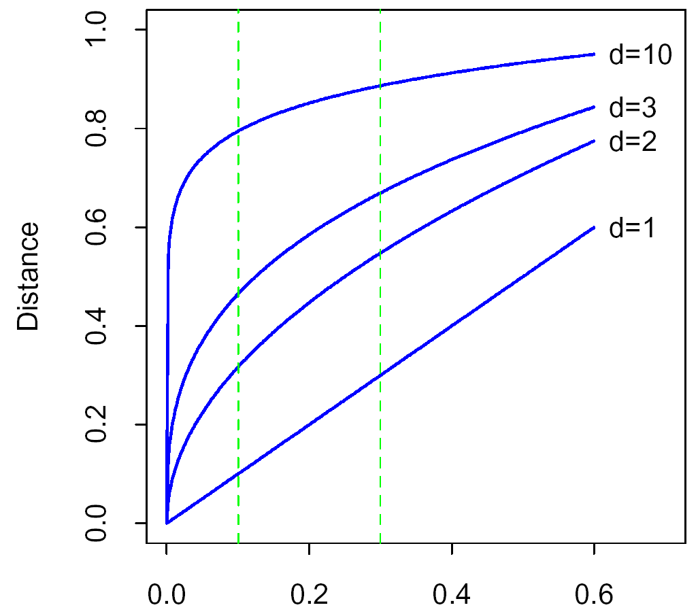
Local Methods in High Dimensions
To cover 1% of the data we must cover 63% of the range of an input variable
Reducing r reduces the number of observations and thus the stability

Slide 27

Local Methods in High Dimensions
In high dimensions, all sample points are close to the edge of the sample
N data points uniformly distributed in a p-dimensional unit ball centered at the origin
Median distance from the closest point to the origin
d(10,500) = 0.52
More than half the way to the boundary
Sampling density is proportional to N^{1/p}
If N₁ = 100 is a dense sample for one input then N₁₀ = 100¹⁰ is an equally dense sample for 10 inputs.
$$d(p,N)={\left(1−{\frac{1}{2}}^{1/N}\right)}^{1/p}$$
1/2
1/2
median

Slide 28

Statistical Models
NN methods are the direct implementation of
But can fail in two ways
With high dimensions NN need not be close to the target point
If special structure exists in the problem, this can be used to reduce variance and bias
$$f(x)=E(Y|X=x)$$

